Slide 1
What is Kafka? Apache Kafka as a messaging service. It is a distributed publisher subscriber messaging system which can handle large volume of data. Kafka messages are persisted on the disk and replicated within the cluster to prevent data loss. Kafka is built on top of the ZooKeeper synchronization service.
What is a Messaging System?
A Messaging System is responsible for transferring data from one application to another, so the applications.
Messages are queued asynchronously between client applications and messaging system. Two types of messaging patterns are available − one is point to point and the other is publish-subscribe (pub-sub).
Disadvantages of point-to-point system
In a point-to-point system, messages are persisted in a queue. One or more consumers can consume the messages in the queue, but a particular message can be consumed by a maximum of one consumer only. Once a consumer reads a message in the queue, it disappears from that queue.
What is Publish-Subscribe Messaging System?
Messages are persisted in a topic. Consumers can subscribe to one or more topic and consume all the messages in that topic. In the Publish-Subscribe system, message producers are called publishers and message consumers are called subscribers.
Ex: A real-life example is Dish TV, which publishes different channels like sports, movies, music, etc., and anyone can subscribe to their own set of channels and get them whenever their subscribed channels are available.

Slide 2
Who uses Kafka?
A lot of large companies who handle a lot of data use Kafka.
LinkedIn, where it originated, uses it to track activity data and operational metrics.
Twitter uses it as part of Storm to provide a stream processing infrastructure.
Square uses Kafka as a bus to move all system events to various Square data centers (logs, custom events, metrics, and so on), outputs to Splunk, for Graphite (dashboards), and to implement Esper-like/CEP alerting systems.
It's also used by other companies like Spotify, Uber, Tumbler, Goldman Sachs, PayPal, Box, Cisco, CloudFlare, and Netflix.

Slide 3
Why Kafka?
It has high reliability and can be scaled easily.
Kafka supports low latency message delivery and gives guarantee for fault tolerance in the presence of machine failures.
It has high throughput and it can perform 2 millions writes per second.
Kafka persists all data to the disk so no data loss.
Log Aggregation Solution : Kafka can be used across an organization to collect logs from multiple services and make them available in a standard format to multiple con-sumers.
Stream Processing : Popular frameworks such as Storm and Spark Streaming read data from a topic, processes it, and write processed data to a new topic where it becomes available for users and applications. Kafka’s strong durability is also very useful in the context of stream processing.
Kafka is often used in real-time streaming data architectures to provide real-time analytics. Kafka is used in use cases where JMS, RabbitMQ, and AMQP may not even be considered due to volume and responsiveness.
Kafka can work with Flume, Spark Streaming, Storm, HBase, Flink, and Spark for real-time ingesting, analysis and processing of streaming data. Kafka is a data stream used to feed Hadoop BigData systems. Kafka brokers support massive message streams for low-latency follow-up analysis in Hadoop or Spark. Also, Kafka Streaming (a subproject) can be used for real-time analytics.

Slide 4
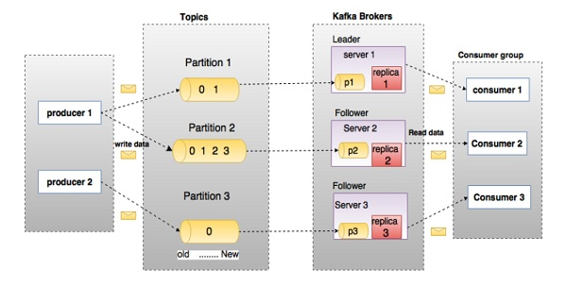
Kafka Architecture

Slide 5
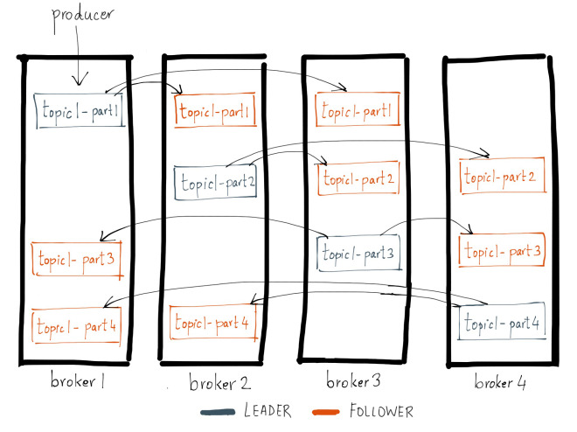

Slide 6
Use cases:
Used as a log aggregator, collect logs from different micro services.
It is used in zipkin, which is a distributed tracing system.
It consume real time data.
Used for event sourcing in microservices.
t has the ability to handle a large number of diverse consumers.
Kafka is very fast, performs 2 million writes/sec.
Kafka persists all data to the disk, which essentially means that all the writes go to the page cache of the OS (RAM).
Kafka can serve as a kind of external commit-log for a distributed system. The log helps replicate data between nodes and acts as a re-syncing mechanism for failed nodes to restore their data.
Ingesting data into Hadoop
Guaranteed distributed commit log for in-memory computing (microservices)
Stream processing, website activity tracking, metrics collection

Slide 7
Terminologies Of Kafka
What is a kafka cluster?
Kafka cluster is a cluster that has n number of kafka services running in it i.e. these are individual servers. These individual servers are called as brokers. If a cluster has more than 1 broker, then it is known as Kafka cluster. We can add new broker very easily into a kafka cluster. These broker can scale individually and easily add a new broker into cluster.
What is a zoo keeper?
Zookeeper is used for service registry that registers all these kafka service brokers and it plays the part of routing the requests from producer or consumer to the brokers. All data is actually stored in the zoo keeper and is replicated in the partition. This way data is not lost and if a cluster goes down. Zoo keeper has the record and will replicate immediately. This gives zero downtime for kafka clusters.
What is a topic?
Topics are the message channels. Data is stored in topics.
A stream of messages belonging to a particular category is called a topic.
Topics are split into partitions. For each topic, Kafka keeps a minimum of one partition. Each such partition contains messages in an immutable ordered sequence. A partition is implemented as a set of segment files of equal sizes.
Poll
A consumer is normally a long-running application. A consumer requests messages from Kafka by calling Consumer.poll(...) regularly. The consumer calls poll(), receives a batch of messages, processes them promptly, and then calls poll() again.

Slide 8
Terminologies Of Kafka
Partition
Topics may have many partitions, so it can handle an arbitrary amount of data.
A server can be partitioned into n number of memory chunks and this partition are linked to topics.
Data is stored in the partition and if the partition is full then we can use another partition.
Partition offset
Each partitioned message has a unique sequence id called as offset.
Replicas of partition
Replicas are nothing but backups of a partition. Replicas are never read or write data. They are used to prevent data loss.
What is a consumer group?
Consumer group all the consumers together for better handling of throughput coming from the producers.
The main way we scale data consumption from a Kafka topic is by adding more consumers to a consumer group. It is common for Kafka consumers to do high-latency operations such as write to a database or a time-consuming computation on the data.
Who can be a leader? What is the meaning of follower?
Leader node is responsible for all read and write operation on a given partition. Each partition has one server acting as a leader.
Follower node just follows the leader instructions.
In the leader fail one of the follower will act as a leader. When a leader goes down, the follower immediately becomes a consumer, pulls the data and update into its own datastore.

Slide 9
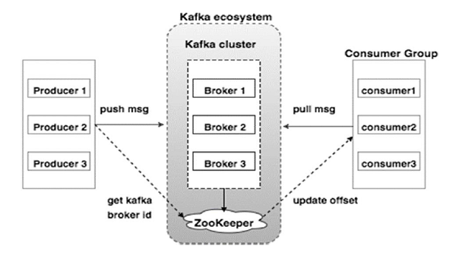
Role of ZooKeeper
Critical information is stored in the Zookeeper and it normally replicates this data across its ensemble, failure of Kafka broker / Zookeeper does not affect the state of the Kafka cluster. Kafka will restore the state, once the Zookeeper restarts. This gives zero downtime for Kafka. The leader election between the Kafka broker is also done by using Zookeeper in the event of leader failure.

Slide 10
Heartbeats
The way consumers maintain membership in a consumer group and ownership of the partitions assigned to them is by sending heartbeats to a Kafka broker designated as the group coordinator (this broker can be different for different consumer groups). As long as the consumer is sending heartbeats at regular intervals, it is assumed to be alive, well, and processing messages from its partitions. Heartbeats are sent when the consumer polls (i.e., retrieves records) and when it commits records it has consumed.
If the consumer stops sending heartbeats for long enough, its session will time out and the group coordinator will consider it dead and trigger a rebalance. If a consumer crashed and stopped processing messages, it will take the group coordinator a few seconds without heartbeats to decide it is dead and trigger the rebalance. During those seconds, no messages will be processed from the partitions owned by the dead consumer. When closing a consumer cleanly, the consumer will notify the group coordinator that it is leaving, and the group coordinator will trigger a rebalance immediately, reducing the gap in processing. Later in this chapter we will discuss configuration options that control heartbeat frequency and session timeouts and how to set those to match your requirements.

Slide 11
Consumer Details
key.deserializer: The class used to deserialize keys
value.deserializer: The class used to deserialize values.
group.id: An identifier for the consumer group that the consumer belongs to.
auto.offset.reset: The behavior when the consumer has no initial offset or the current offset is no longer available in the cluster.
enable.auto.commit: Determines whether to commit the consumer's offset automatically in the background.
auto.commit.interval.ms: The number of milliseconds between periodic commits of offsets.
max.poll.records: The maximum number of records returned in a call to poll()
session.timeout.ms: The number of milliseconds within which a consumer heartbeat must be received to maintain a consumer's membership of a consumer group.
max.poll.interval.ms: The maximum time interval between polls before the consumer leaves the group.
A consumer is normally a long-running application. A consumer requests messages from Kafka by calling Consumer.poll(...) regularly. The consumer calls poll(), receives a batch of messages, processes them promptly, and then calls poll() again.
When a consumer processes a message, the message is not removed from its topic. Instead, consumers can choose from several ways of letting Kafka know which messages have been processed. This process is known as committing the offset.
The Java class org.apache.kafka.clients.consumer.ConsumerRecord is used to represent a message for the consumer API. The terms record and message can be used interchangeably, but essentially a record is used to represent a message.

Slide 12
Kafka auto commit and auto.commit.interval.ms
The auto-commit enabled, a call to poll will always commit the last offset returned by the previous poll. It doesn’t know which events were actually processed, so it is critical to always process all the events returned by poll before calling poll again (or before calling close(), it will also automatically commit offsets
enable.auto.commit=true
auto.commit.interval.ms=10
Use Case:
Suppose I call poll() method in a loop
On first call to poll(), I get 1000 messages (offset 2000-3000) and it takes 1 ms to process all 1000 messages
After auto-commit interval passed, the next call to poll will commit all processed messages.
Let's say, you call poll each 1 ms, and set commit-interval to 10ms. Thus, in every call to poll will commit (and this commit covers all messages from the last 10 poll calls).

Slide 13
Difference between kafka pub-sub and kafka queue based messaging system
In a queue messaging system instead of a single consumer, a group of consumers having the same Group ID will subscribe to a topic. In simple terms, consumers subscribing to a topic with same Group ID are considered as a single group and the messages are shared among them. BUT ITS WEAKNESS IS, IT IS NOT MULTI-SUBSCRIBER, AS SOON AS ONE PROCESS READS THE DATA IT’S GONE.
Kafka Publish-Subscribe
Whereas in this Kafka Publish-Subscribe system, the record is broadcast to all the Kafka consumers. It permits us to broadcast data to multiple processes. However,. IT ALSO HAS SOME LIMITATIONS, LIKE THERE IS NO WAY OF SCALING PROCESSING BECAUSE HERE EVERY MESSAGE GOES TO EVERY SUBSCRIBER
Here the collection of processes refers to the members of the consumer group. Moreover, Kafka permits us to broadcast messages to multiple consumer groups, with Kafka publish-subscribe.
So, the main benefit of Kafka’s model is both these properties are available in every Kafka topic —it can scale processing as well as it is multi-subscriber. Hence, that implies we do not have to select one or the other.

Slide 14
Use Case 1:
Data Type: String
A string message will be published using Producer and sent to a particular predefined Topic. Consumer will consume the messages from the topic using a java program. No need of Kafka configuration classes as everything will be taken care from property file. It is not recommended as we cannot make json data type work with this. Message type is only for string and not json.
Documentation Link:
https://github.com/soumyadeep-saha/SpringBootApacheKafkaAllProjects/blob/master/SpringbootKafkaConfluent/ProducerConsumerSameAPI.txt
Github Link:
https://github.com/soumyadeep-saha/SpringBootApacheKafkaAllProjects/tree/master/SpringbootKafkaConfluent
Aplication.properties
spring.kafka.consumer.bootstrap-servers=localhost:9092
spring.kafka.consumer.group-id=group_id
spring.kafka.consumer.auto-offset-reset=earliest
spring.kafka.consumer.key-deserializer=org.apache.kafka.common.serialization.StringDeserializer
spring.kafka.consumer.value-deserializer=org.apache.kafka.common.serialization.StringDeserializer
spring.kafka.producer.bootstrap-servers=localhost:9092
spring.kafka.producer.key-serializer=org.apache.kafka.common.serialization.StringSerializer
spring.kafka.producer.value-serializer=org.apache.kafka.common.serialization.StringSerializer

Slide 15
Use Case 2:
Data Type: Json
A JSON messages will be published using Producer and sent to a particular predefined Topic. Consumer will consume all the messages from the topic using a java program. Created ReceiverConfig.java and SenderConfig.java for the Kafka configuration to work with JSON using JsonDeserializer which is recommended as we have control over lots of things. Message type is JSON.
Documentation Link:
https://github.com/soumyadeep-saha/SpringBootApacheKafkaAllProjects/blob/master/SpringBootKafkaJsonData/SpringbootKafkaJsonSerializerDeserializer.txt
Github Link:
https://github.com/soumyadeep-saha/SpringBootApacheKafkaAllProjects/tree/master/SpringBootKafkaJsonData

Slide 16
Use Case 3: (Recommended)
Data Type: Json Object
A JSON messages will be published using Producer and sent to a particular predefined Topic. Topic is created using java program using NewTopic and KafkaAdmin with required partition and replication factor which is configurable using KafkaTopicConfig.java. Consumer will consume all the messages from the topic from a particular or all partitions using a java program. Here using this concepts we have control over lots of configurations. Created ReceiverConfig.java and SenderConfig.java for the Kafka configuration to work with JSON using JsonDeserializer which is recommended as we have control over lots of things. Message type is JSON.
Documentation Link:
https://github.com/soumyadeep-saha/SpringBootApacheKafkaAllProjects/blob/master/SpringbootKafkaOffsetPartition/SpringbootKafkaOffsetPartition.txt
Github Link:
https://github.com/soumyadeep-saha/SpringBootApacheKafkaAllProjects/tree/master/SpringbootKafkaOffsetPartition

Slide 17
Redis | Kafka
Redis is a in memory system. Redis is only useful for online operational messaging | Kafka is a file based system, which keeps only the active data in memory and keeps flushing old data to file at some interval. Kafka is best used in high volume data processing pipelines.
Messages can be retained only within the limit of memory allocated to Redis. Hence, Redis should be used in a system which requires almost realtime messages and With not much delay. | Kafka provides a greater message retention. Any Message queue in Kafka is broken into multiple partitions.
Clients can read only one message at a time. Low/Medium through put should be achievable in Redis. | Client can read messages from all be partitions in parallel. Kafka is also called as distributed message broker.
Redis can go out of memory | Kafka is protecting from bursts
Persistence is less in redis | Kafka can keep events much (configurably) longer due to persistence
Only one message at a time can be read | Events can be consumed multiple times by multiple consumer groups
Better to use when you have short lived messages and where you will have more consumer capacity that you have publishing throughput so as to not run out of memory. | Instead of pushing data to consumers, consumers keep track of the most recent data they have read and can ask for the next set of data after that high water mark. This design allows Kafka to support real time consumers as well as batch consumers (hourly or daily hadoop jobs for instance).

Slide 18
 | RabbitMQ | Kafka
Time Decoupling | RabbitMQ will store the messages in DRAM as long as possible, but once the available DRAM is completely consumed, RabbitMQ will start storing messages on disk without having a copy available in DRAM, which will severely impact performance. | Kafka, on the other hand, was specifically designed with the various consumption rates requirement in mind and hence is much better positioned to handle a wider scale of time decoupling.
Delievery Guarantees: | At least once with order conservation: RabbitMQ sorts messages when writing them to queue structures, meaning that lost messages can be correctly delivered in order without the need to resend the full batch that lost 1 or more messages. | At least once without order conservation: Kafka cannot preserve order when sending to multiple partitions.
Ordering Guarantees: | RabbitMQ will conserve order for flows using a single AMQP channel. It also reorders retransmitted packets inside its queue logic so that a consumer does not need to resequence buffers. | Kafka will conserve order only inside a partition. Furthermore, within a partition, Kafka guarantees that a batch of messages either all pass or all fail together.
Availability: | RabbitMQ Clusters can be configured to replicate all the exchange and binding information. However, it will not automatically create mirrored queues (RabbitMQ’s terminology for replicated queues) and will require explicit setting during queue creation. | Kafka availability requires running the system with a suitably high replication factor.
Thouughput: | RabbitMQ is mainly constrained by routing complexity (up till frame sizes of a few 1000 bytes, at which time packet copying becomes non-negligible). | Kafka is not as low as that of RabbitMQ. Two potential causes for these variations are: (i) Kafka relies on OS level caching of disk access, which is a complex hidden subsystem that cannot be accurately modeled or even controlled and is shared across everything that runs on the machine (ii) Kafka runs on the JVM, which has much more variability than an Erlang VM due to unsophisticated locking mechanisms and the garbage collection process.

Slide 19
We wanted to consume the records after a certain interval (e.g. every 5 minutes). Consumer properties are standard:
@Bean
public KafkaListenerContainerFactory<ConcurrentMessageListenerContainer<Integer, String>> kafkaListenerContainerFactory() {
ConcurrentKafkaListenerContainerFactory<Integer, String> factory = new ConcurrentKafkaListenerContainerFactory<>();
factory.setConsumerFactory(consumerFactory());
factory.setConcurrency(1);
factory.setBatchListener(true);
factory.getContainerProperties().setPollTimeout(300000);
factory.getContainerProperties().setAckMode(AbstractMessageListenerContainer.AckMode.BATCH);
return factory;
}
You cannot control the rate at which the consumer polls, the pollTimeout is how long the poll() will wait for new records to arrive. If new records arrive more often, it will not wait that long.

Slide 20
Kafka Streams
Kafka Streams is a client library for building applications and microservices, where the input and output data are stored in Kafka clusters. It combines the simplicity of writing and deploying standard Java and Scala applications on the client side with the benefits of Kafka's server-side cluster technology.
Kafka Streams is a library for building streaming applications, specifically applications that transform input Kafka topics into output Kafka topics (or call external services, update databases, etc.). Kafka Streams allows you do this with concise code in a way that is distributed and fault-tolerant.
KafkaStreams enables us to consume from Kafka topics, analyze or transform data, and potentially, send it to another Kafka topic.
Important to note is that the KafkaStreams library isn’t reactive and has no support for async operations and backpressure handling.
Building a Streaming Topology → how events should be handled and transformed.
Process the input and send to downstream systems
Starting KafkaStream Job
A KStream is an abstraction of a record stream, where each data record represents a self-contained datum in the unbounded data set. Using the table analogy, data records in a record stream are always interpreted as an "INSERT" -- think: adding more entries to an append-only ledger -- because no record replaces an existing row with the same key. Examples are a credit card transaction, a page view event, or a server log entry.
A KTable is an abstraction of a changelog stream, where each data record represents an update. More precisely, the value in a data record is interpreted as an "UPDATE" of the last value for the same record key, if any (if a corresponding key doesn't exist yet, the update will be considered an INSERT).

Slide 21
Why kafka Streams?
Elastic, highly scalable, fault-tolerant
Deploy to containers, VMs, bare metal, cloud
Equally viable for small, medium, & large use cases
Fully integrated with Kafka security
Write standard Java and Scala applications
Exactly-once processing semantics
No separate processing cluster required
Develop on Mac, Linux, Windows
Who uses Kafka streams?
A lot of large companies who handle a lot of data use Kafka.
The New York Times
Trivago is a global hotel search platform.
LINE uses Apache Kafka
As the leading online fashion retailer in Europe, Zalando uses Kafka as an ESB (Enterprise Service Bus), which helps us in transitioning from a monolithic to a micro services architecture. Using Kafka for processing event streamsenables our technical team to do near-real time business intelligence.

Slide 22
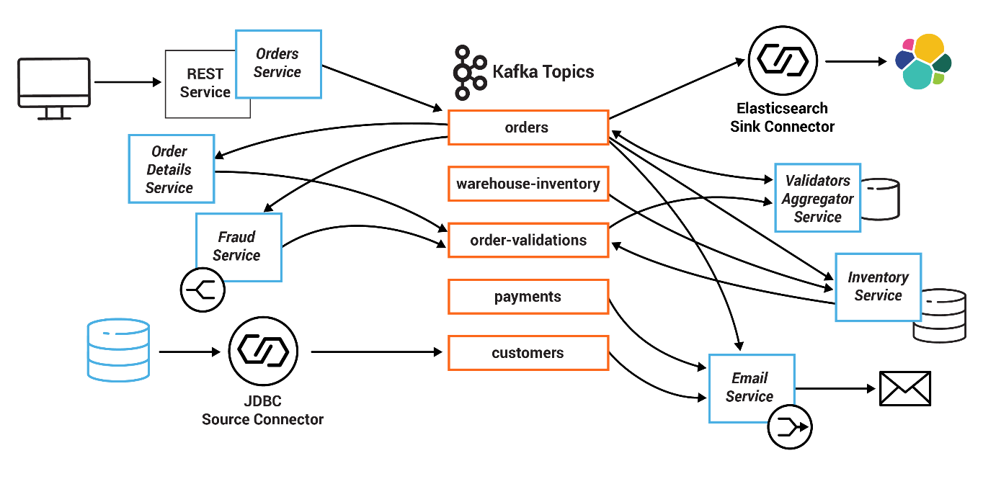

Slide 23
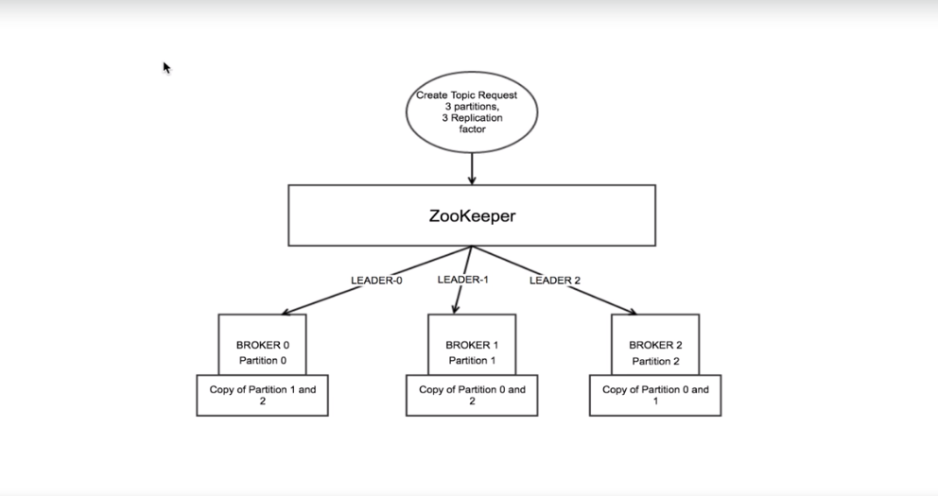
Partition Replication
Partitions allow you to parallelize a topic by splitting the data in a particular topic across multiple brokers.
Every partition (replica) has one server acting as a leader and the rest of them as followers. The leader replica handles all read-write requests for the specific partition and the followers replicate the leader. If the leader server fails, one of the follower servers become the leader by default. When a producer publishes a message to a partition in a topic, it is forwarded to its leader. The leader appends the message to its commit log and increments its message offset. Kafka only exposes a message to a consumer after it has been committed and each piece of data that comes in will be stacked on the cluster.

Slide 24
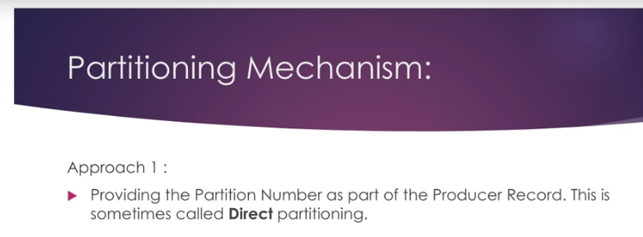
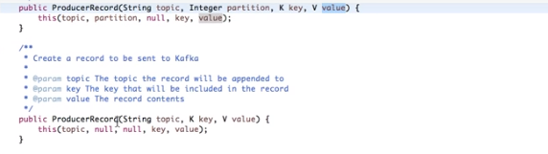
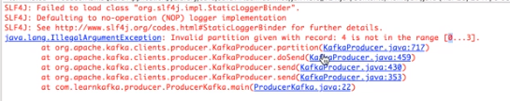

Slide 25
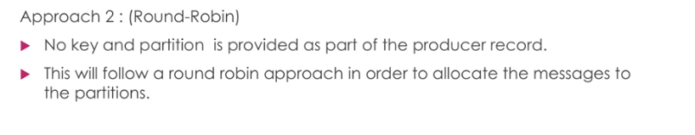

Slide 26
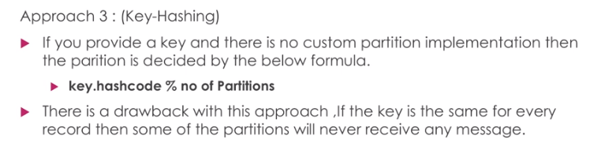

Slide 27
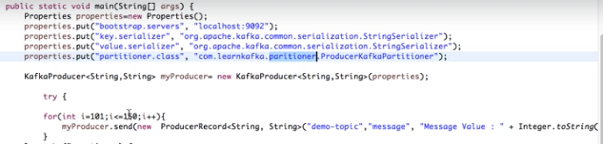
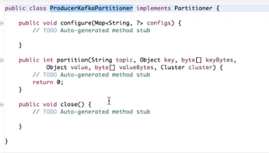
Custom Partition

Slide 28
Terminologies Of Kafka
Brokers
When (brokers = partitions)
Brokers are simple system responsible for maintaining the published data. Each broker may have zero or more partitions per topic. Assume, if there are N partitions in a topic and N number of brokers, each broker will have one partition.
When (brokers > partitions)
Assume if there are N partitions in a topic and more than N brokers (n + m), the first N broker will have one partition and the next M broker will not have any partition for that particular topic.
When (brokers < partitions)
Assume if there are N partitions in a topic and less than N brokers (n-m), each broker will have one or more partition sharing among them. This scenario is not recommended due to unequal load distribution among the broker.
Producers
Producers push data to brokers. When the new broker is started, all the producers search it and automatically sends a message to that new broker. Kafka producer doesn’t wait for acknowledgements from the broker and sends messages as fast as the broker can handle.
Consumers
Since Kafka brokers are stateless, which means that the consumer has to maintain how many messages have been consumed by using partition offset. If the consumer acknowledges a particular message offset, it implies that the consumer has consumed all prior messages. The consumer issues an asynchronous pull request to the broker to have a buffer of bytes ready to consume. The consumers can rewind or skip to any point in a partition simply by supplying an offset value. Consumer offset value is notified by ZooKeeper.

Slide 29
Workflow of Pub-Sub Messaging
Producers send message to a topic at regular intervals.
Kafka broker stores all messages in the partitions configured for that particular topic. It ensures the messages are equally shared between partitions. If the producer sends two messages and there are two partitions, Kafka will store one message in the first partition and the second message in the second partition.
Consumer subscribes to a specific topic.
Once the consumer subscribes to a topic, Kafka will provide the current offset of the topic to the consumer and also saves the offset in the Zookeeper ensemble.
Consumer will request the Kafka in a regular interval for new messages.
Consumer will receive the message and process it.
Once the messages are processed, consumer will send an acknowledgement to the Kafka broker.
Once Kafka receives an acknowledgement, it changes the offset to the new value and updates it in the Zookeeper. Since offsets are maintained in the Zookeeper, the consumer can read next message correctly even during server outrages.
This above flow will repeat until the consumer stops the request.
Consumer has the option to rewind/skip to the desired offset of a topic at any time and read all the subsequent messages.

Slide 30
Consumer group is a multi-threaded or multi-machine consumption from Kafka topics.
Consumer Group
Consumers can join a group by using the samegroup.id.
The maximum parallelism of a group is that the number of consumers in the group ← no of partitions.
Kafka assigns the partitions of a topic to the consumer in a group, so that each partition is consumed by exactly one consumer in the group.
Kafka guarantees that a message is only ever read by a single consumer in the group.
Consumers can see the message in the order they were stored in the log.
Re-balancing of a Consumer
Adding more processes/threads will cause Kafka to re-balance. If any consumer or broker fails to send heartbeat to ZooKeeper, then it can be re-configured via the Kafka cluster. During this re-balance, Kafka will assign available partitions to the available threads, possibly moving a partition to another process.

